Slide 1
Info Slide for Group
On avg, each person should speak for ~2min, aiming for 10-12min presentation
There’s 25 slides with titles. This may be too many to appropriately manage time. I’ve put section timing on each section. If you go over this, feel free to reduce the information in the section to fit. Each need to contribute ~3-4 slides
Group A: Jose, Peter, Mouri
Group B: Austyn, Michael, Louis

Slide 2
Table of Contents
Introduction (~1 min, A)
Background and Motivation
Research Objectives
Presentation Overview
Literature Review (~3 min, A)
Graph Convolutional Networks and their Applications
Gated Recurrent Units and their Applications
Previous Wind Speed Prediction using Machine Learning
Methodology (~4 min, B)
Description of Data
Preprocessing Steps
Proposed GCN-GRU Model
Model Training and Validation

Slide 3
Table of Contents
Results (~ 2 min, B)
Performance Evaluation of GCN-GRU Model
Comparison to related Works
Discussion of Results
Conclusion (~1 min, B)
Summary of Research Findings
Contributions and Study Limitations
References (0 min)

Slide 4
A Recurrent Graph-Convolutional Network for Wind Speed Prediction
Forecasting Southern Alberta’s Wind Speed
Jose Carmo
Louis-Antoine Etchian
Michael Francis Austyn Nagribianko
Peter Yaun Mouri Zakir
April 3, 2023

Slide 5
Table of Contents
Introduction
Background and Motivation
Research Objectives
Presentation Overview
Literature Review
Graph Convolutional Networks and their Applications
Gated Recurrent Units and their Applications
Previous Wind Speed Prediction using Machine Learning
Methodology
Description of Data
Preprocessing Steps
Proposed GCN-GRU Model
Model Training and Validation

Slide 6
Table of Contents
Results
Performance Evaluation of GCN-GRU Model
Comparison to Related Works
Discussion of Results
Conclusion
Summary of Research Findings
Contributions and Study Limitations
References

Slide 7
I. Introduction

Slide 8
I. Background and Motivation
Background: wind turbines rely on accurate wind speed forecasts to properly bid generation, what are the pitfalls? What goes wrong when unreliable forecasts are used? I can answer this question (Austyn)
Motivation: the motivation for using this is to develop an accurate forecasting model that incorporates numerous stations to predict wind speed data

Slide 9
I. Research Objectives
What are the measurable goals we are wishing to achieve with this project?

Slide 10
I. Presentation Overview
Brief (~30s) overview of what’s involved in this
Literature review
Methodology including: ~~~~
Results and comparison to benchmark models
Conclusion and future work

Slide 11
II. Literature Review

Slide 12
II. Graph Convolutional Networks and their Applications

Slide 13
II. Gated Recurrent Units and their Applications

Slide 14
II. Previous Wind Speed Prediction using Machine Learning
Be sure to include benchmark MAE, MAPE values here to reference in results

Slide 15
III. Methodology

Slide 16
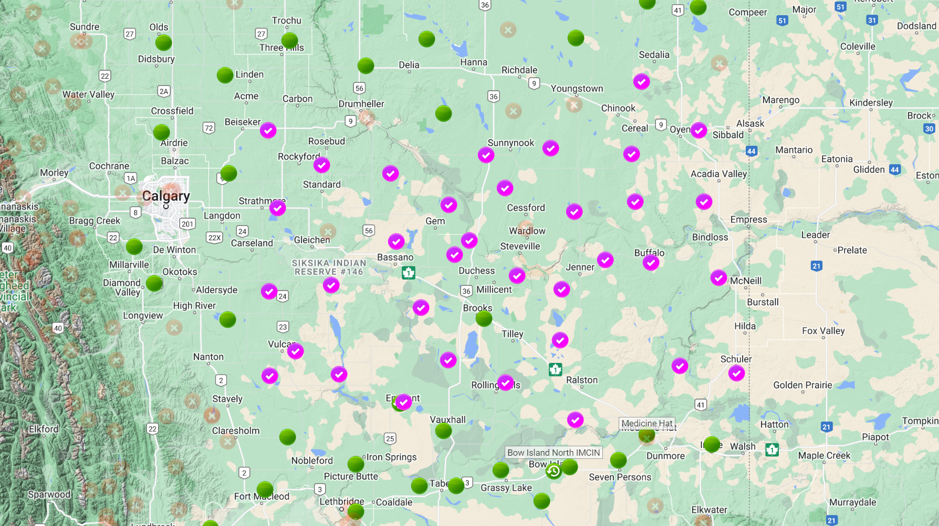
III. Description of Data

Slide 17
III. Description of Data

Slide 18
III. Preprocessing Steps

Slide 19
III. Proposed GCN-GRU Model

Slide 20
III. Model Training and Validation

Slide 21
V. Results

Slide 22
V. Performance Evaluation of GCN-GRU Model

Slide 23
V. Comparison to related Works
Study Group | RMSE | RMSE (Large) | MAE | MAE (Large)
Chen et al. – 1 hour forecast | 1.620 |  | 1.538
Chen et al. – 2 hour forecast | 1.867 |  | 1.762
Stanczyk and Mehrkanoon – 2 hour forecast | 10.57 |  | 7.96
Liu and Ware – 1 hour forecast | 5.900 | 3.3798 | 4.346 | 2.766
Liu and Ware – 2 hour forecast | 6.9127 | 3.881 | 5.153 | 2.939
Liu and Ware – 3 Hour forecast | 7.845 | 4.252 | 5.884 | 3.206
Our work – 1 hour forecast | 3.306 | 3.639 | 1.595 | 2.863
Our work – 2 hour forecast | 4.561 | 4.714 | 3.603 | 3.705
Our work – 3 hour forecast | 5.08 | 5.658 | 3.937 | 4.388

Slide 24
V. Discussion of Results
We have comparable results to existing work
Our MAE shows that this model has promise to optimize wind power:
<3 km/hr for 1 hour forecast
<4 km/hr for 2 hour forecast
<5 km/hr for 3 hour forecast

Slide 25
VI. Conclusion

Slide 26
VI. Conclusion
We combined a GCN model with a GRU model for wind forecasting
We achieved similar results to existing work with fairly high accuracy
Future work can examine the computation cost of more data or the accuracy of wind power forecasting

Slide 27
VII. References

Slide 28
VI. Discussion of Results

